Slide 1

Image Source

Slide 2
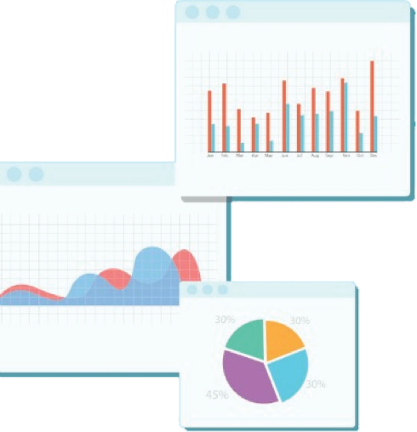

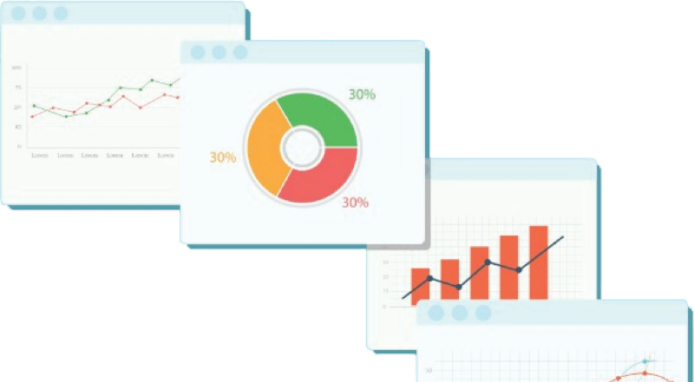
Welcome to Week 10
Lecture 2!
Data Science in Python &
Machine Learning

Slide 3
Review: What’s wrong with this code?
There are 7 mistakes. Use the annotation tool to circle one, type one chat, or say one outloud
from sklearn.decomposition import PCA
from sklearn.preprocessing import StandardScaler
from sklearn.model_selection import train_test_split
import pandas as pd
df = pd.read_csv(‘/content/data.csv’)
X = df.drop(columns=‘target’)
y = df[‘target’]
X_train, X_test, y_train, y_test = train_test_split(X, y, random_state=42)
pca_pipe = make_pipeline(StandardScaler(), PCA(n_components=.95))
X_train_proc = pca_pipe.fit_transform(X_train)
X_test_proc = pca_pipe.transform(X_test)

Slide 4
Learning Objectives
Identify features for engineering
Select appropriate engineering strategies
Create non-linear feature combinations with PolynomialFeatures
Apply feature engineering to a dataset to improve model performance

Slide 5
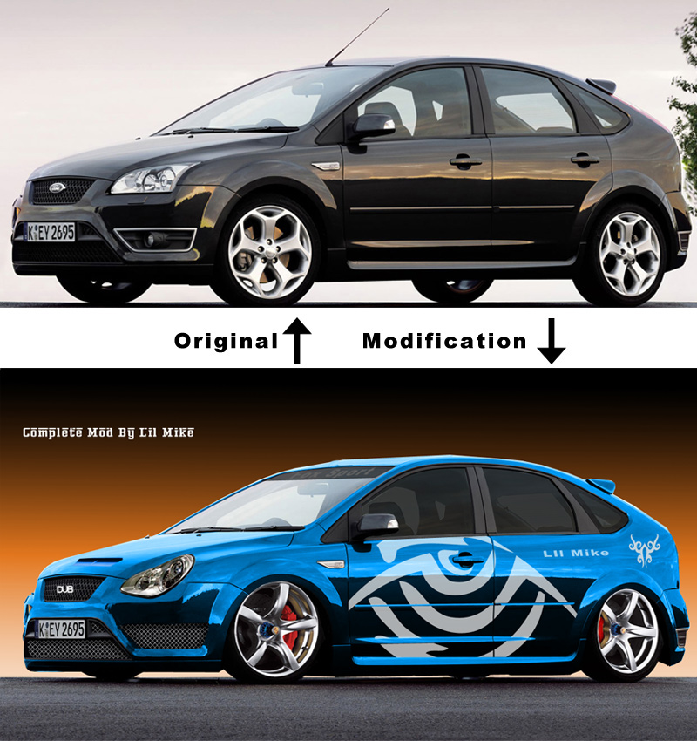
Feature Engineering
Changes features in some way
Unlock information in your data
Allow your model to look at data in new ways.
Image thank to slaughterdbc

Slide 6
Feature Engineering Review
Engineering Skill | Application
Scaling | StandardScaler, MinMaxScaler
Encoding | OneHotEncoder, OrdinalEncoder
Dimensionality Reduction | PCA, LDA
Overloaded Operators | col1 + col2, col2 - col2, col1 * col2, col1**2
String Operators | col1.str.split(), col1.str.strip(), col1 + ‘ ‘ + col2
Datetime | col.dt.hour, col.dt.day_name(), col.dt.month
Apply Functions | col.apply(lambda x: 1 if x > 50 else 0)

Slide 7
Overloaded Operator Ideas
Combine Features
df[‘bed_bath_ratio’] = df[‘beds’] / df[‘baths’]
df[‘total_candy’] = df[‘chocolate’] \ + df[‘bubblegum’] \ + df[‘taffy’]
Transform Features
df[‘squared_latitude’] = df[‘latitude’]**2
df[‘sqrt_income’] = df[‘income’]**.5

Slide 8
Datetime Ideas
Extract More Information
df[‘month’] = df[‘datetime’].dt.month_name()
df[‘hour’] = df[‘datetime’].dt.hour

Slide 9
New Ideas:
Binning
Group numeric into ranges
Combine categories
Change from regression classification
Change from multiclass to binary
Polynomial Encoding
Numeric features
Adds products and powers of features as new feature
Makes numeric columns non-linear

Slide 10
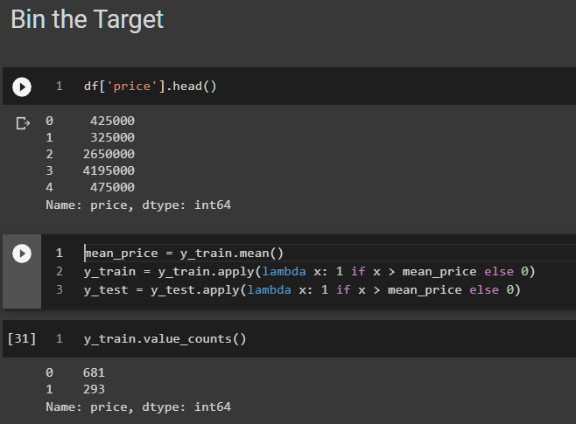
Binning: What it does
Combines numeric ranges or groups of categories into or bins or combination categories
Think histograms
Uses:
Change regression to classification, which may be easier to model
Change multiclass classification to binary classification, which may be easier to model
Reduce cardinality of features

Slide 11






Binning: What it does
Use .apply() to transform features (or targets!)
df[‘is_mammal’] = df[‘animal’].apply(lambda x: 1 if x in [‘dog’, ‘cat’, ‘horse’] else 0)
Old Categories
New Categories
Mammal (1)
Non-mammal (0)

Slide 12



Binning: What it does
Use .apply() to transform features (or targets!)
df[‘is_tall’] = df[‘height’].apply(lambda x: 1 if x > 72 else 0)
80
77
62
9
70
New Categories
Tall (1)
Non-tall (0)

Slide 13
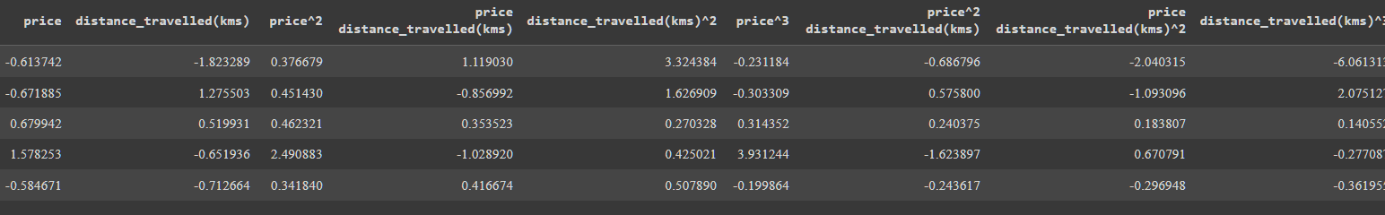
PolynomialFeatures: What it does
Adds new numeric features
Products and powers of original features

Slide 14
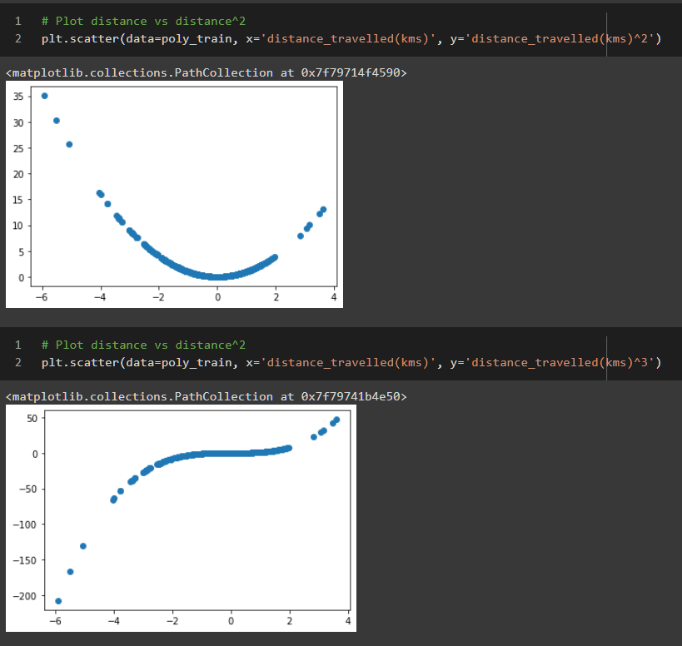
PolynomialFeatures: What it does
Pros:
Makes linear features non-linear
Improves the power of linear models
Increases model complexity Cons
Increased model complexity with more features
Higher degrees can create overfitting

Slide 15
Feature Engineering Poll
Which feature engineering strategies would you use?

Slide 16
Feature Engineering Code-along
Code-along Notebook
You can use the link at the top to open the notebook in Colab if desired

Slide 17
Coding Challenge: Feature Engineering
In your breakout group:
Challenge Notebook. You will be predicting house sales in Melbourne, Australia
Open the notebook either locally or in Colab
Quickly choose a driver to code and share their screen.
For each section, choose a feature engineering technique to try
If there is time, fit a model on your resulting data and be ready to share your score.

Slide 18
Assignments Due Friday Morning
PCA Exercise
Feature Engineering Exercise
Project 2 - Part 4
I will be reviewing assignments Friday, Not Monday this week. Just sayin’

Slide 19
Announcements:
Belt Exams are the week after Thanksgiving: December 2nd - 4th
Make sure you are caught up on assignments!
Content from weeks 9-11 will be on the belt exam
Clustering
PCA
Neural network models
Belt Prep and Practice Exam on LP

Slide 20
Announcements:
Special Belt Exam Code Reviews
Next Week’s Code Reviews will be devoted to Belt Exam Prep!!
Review content
Find your weaknesses
Create a study plan
Code Review Sign Up

Slide 21
Week 3 is a Big Week!
Start Early…like Friday Night!
Catch up on Weeks 1 and 2
Week 3 content
Week 3 assignments
Finalize Project 2 Presentation
Prepare for Stack 3 Belt Exam
Daily Schedule

Slide 22
Next Lecture: Intro to Deep Learning
Please Read:
Intro to Deep Learning
Forward Propagation
Activation Functions
Backward Propagation
Neural Networks in Keras

